Slide 1
Congestion Control
Outline
  Queuing Discipline
  Reacting to Congestion
  Avoiding Congestion

Slide 2
Issues
Two sides of the same coin
  pre-allocate resources so at to avoid congestion
  control congestion if (and when) is occurs
Two points of implementation
  hosts at the edges of the network (transport protocol)
  routers inside the network (queuing discipline)
Underlying service model
  best-effort (assume for now)
  multiple qualities of service (later)
Source
1
10-Mbps Ethernet
Router
Destination
1.5-Mbps T1 link
Source
100-Mbps FDDI
2

Slide 3
Framework
Connectionless flows
  sequence of packets sent between source/destination pair
  maintain soft state at the routers
Taxonomy
  router-centric versus host-centric
  reservation-based versus feedback-based
  window-based versus rate-based
Source
1
Router
Destination
1
Source
Router
2
Router
Destination
2
Source
3

Slide 4
Evaluation
Fairness
Power (ratio of throughput to delay)
Throughput/delay
Optimal
Load
load

Slide 5
Queuing Discipline
First-In-First-Out (FIFO)
  does not discriminate between traffic sources
Fair Queuing (FQ)
  explicitly segregates traffic based on flows
  ensures no flow captures more than its share of capacity
  variation: weighted fair queuing (WFQ)
Problem?
Flow 1
Flow 2
Round-robin
service
Flow 3
Flow 4

Slide 6
FQ Algorithm
Suppose clock ticks each time a bit is transmitted
Let P_{i} denote the length of packet i
Let S_{i} denote the time when start to transmit packet i
Let F_{i} denote the time when finish transmitting packet i
F_{i} = S_{i} + P_{i}
When does router start transmitting packet i?
  if before router finished packet i - 1 from this flow, then immediately after last bit of i - 1 (F_{i-1})
  if no current packets for this flow, then start transmitting when arrives (call this A_{i})
Thus: F_{i} = MAX (F_{i - 1}, A_{i}) + P_{i}

Slide 7
FQ Algorithm (cont)
For multiple flows
  calculate F_{i} for each packet that arrives on each flow
  treat all F_{i}’s as timestamps
  next packet to transmit is one with lowest timestamp
Not perfect: can’t preempt current packet
Example
Flow 1
Flow 2
Flow 1
Flow 2
Output
(arriving)
(transmitting)
Output
F = 8
F = 10
F = 10
F = 5
F = 2
(a)
(b)

Slide 8
TCP Congestion Control
Idea
  assumes best-effort network (FIFO or FQ routers)each source determines network capacity for itself
  uses implicit feedback
  ACKs pace transmission (self-clocking)
Challenge
  determining the available capacity in the first place
  adjusting to changes in the available capacity

Slide 9
Additive Increase/Multiplicative Decrease
Objective: adjust to changes in the available capacity
New state variable per connection: CongestionWindow
  limits how much data source has in transit
  MaxWin = MIN(CongestionWindow, AdvertisedWindow)
  EffWin = MaxWin - (LastByteSent - LastByteAcked)
Idea:
  increase CongestionWindow when congestion goes down
  decrease CongestionWindow when congestion goes up

Slide 10
AIMD (cont)
Question: how does the source determine whether or not the network is congested?
Answer: a timeout occurs
  timeout signals that a packet was lost
  packets are seldom lost due to transmission error
  lost packet implies congestion

Slide 11
AIMD (cont)
Source
Destination
Algorithm
  increment CongestionWindow by one packet per RTT (linear increase)
  divide CongestionWindow by two whenever a timeout occurs (multiplicative decrease)
…
In practice: increment a little for each ACK
Increment = (MSS * MSS)/CongestionWindow
CongestionWindow += Increment

Slide 12
AIMD (cont)
Trace: sawtooth behavior
70
60
50
KB
40
30
20
10
1.0
2.0
3.0
4.0
5.0
6.0
7.0
8.0
9.0
10.0
T
ime (seconds)

Slide 13
Slow Start
Source
Destination
Objective: determine the available capacity in the first
Idea:
  begin with CongestionWindow = 1 packet
  double CongestionWindow each RTT (increment by 1 packet for each ACK)
…

Slide 14
Slow Start (cont)
Exponential growth, but slower than all at once
Used…
  when first starting connection
  when connection goes dead waiting for timeout
Trace
Problem: lose up to half a CongestionWindow’s worth of data
70
60
50
KB
40
30
20
10
1.0
2.0
3.0
4.0
5.0
6.0
7.0
8.0
9.0

Slide 15
Fast Retransmit and Fast Recovery
Problem: coarse-grain TCP timeouts lead to idle periods
Fast retransmit: use duplicate ACKs to trigger retransmission
Sender
Receiver
Packet 1
Packet 2
Packet 3
ACK 1
Packet 4
ACK 2
Packet 5
ACK 2
Packet 6
ACK 2
ACK 2
Retransmit
packet 3
ACK 6

Slide 16
Results
70
60
50
KB
40
30
20
10
1.0
2.0
3.0
4.0
5.0
6.0
7.0
Fast recovery
  skip the slow start phase
  go directly to half the last successful CongestionWindow (ssthresh)

Slide 17
Congestion Avoidance
TCP’s strategy
  control congestion once it happens
  repeatedly increase load in an effort to find the point at which congestion occurs, and then back off
Alternative strategy
  predict when congestion is about to happen
  reduce rate before packets start being discarded
  call this congestion avoidance, instead of congestion control
Two possibilities
  router-centric: DECbit and RED Gateways
  host-centric: TCP Vegas

Slide 18
DECbit
Add binary congestion but to each packet header
Router
  monitors average queue length over last busy+idle cycle
  set congestion bit if average queue length > 1
  attempts to balance throughout against delay
Queue length
Current
time
Previous
Current
T
ime
cycle
cycle
A
veraging
interval

Slide 19
End Hosts
Destination echoes bit back to source
Source records how many packets resulted in set bit
If less than 50% of last window’s worth had bit set
  increase CongestionWindow by 1 packet
If 50% or more of last window’s worth had bit set
  decrease CongestionWindow by 0.875 times

Slide 20
Random Early Detection (RED)
Notification is implicit
  just drop the packet (TCP will timeout)
  could make explicit by marking the packet
Early random drop
  rather than wait for queue to become full, drop each arriving packet with some drop probability whenever the queue length exceeds some drop level

Slide 21
RED Details
Compute average queue length
  AvgLen = (1 - Weight) * AvgLen +
  Weight * SampleLen
    0 < Weight < 1 (usually 0.002)
    SampleLen is queue length each time a packet arrives
MaxThreshold
MinThreshold
A
vgLen

Slide 22
RED Details (cont)
Two queue length thresholds
  if AvgLen <= MinThreshold then
  enqueue the packet
  if MinThreshold < AvgLen < MaxThreshold then
  calculate probability P
  drop arriving packet with probability P
  if ManThreshold <= AvgLen then
  drop arriving packet

Slide 23
RED Details (cont)
Computing probability P
    TempP = MaxP * (AvgLen - MinThreshold)/ (MaxThreshold - MinThreshold)
    P = TempP/(1 - count * TempP)
Drop Probability Curve
P(drop)
1.0
MaxP
A
vgLen
MinThresh
MaxThresh

Slide 24
Tuning RED
Probability of dropping a particular flow’s packet(s) is roughly proportional to the share of the bandwidth that flow is currently getting
MaxP is typically set to 0.02, meaning that when the average queue size is halfway between the two thresholds, the gateway drops roughly one out of 50 packets.
If traffic id bursty, then MinThreshold should be sufficiently large to allow link utilization to be maintained at an acceptably high level
Difference between two thresholds should be larger than the typical increase in the calculated average queue length in one RTT; setting MaxThreshold to twice MinThreshold is reasonable for traffic on today’s Internet
Penalty Box for Offenders

Slide 25
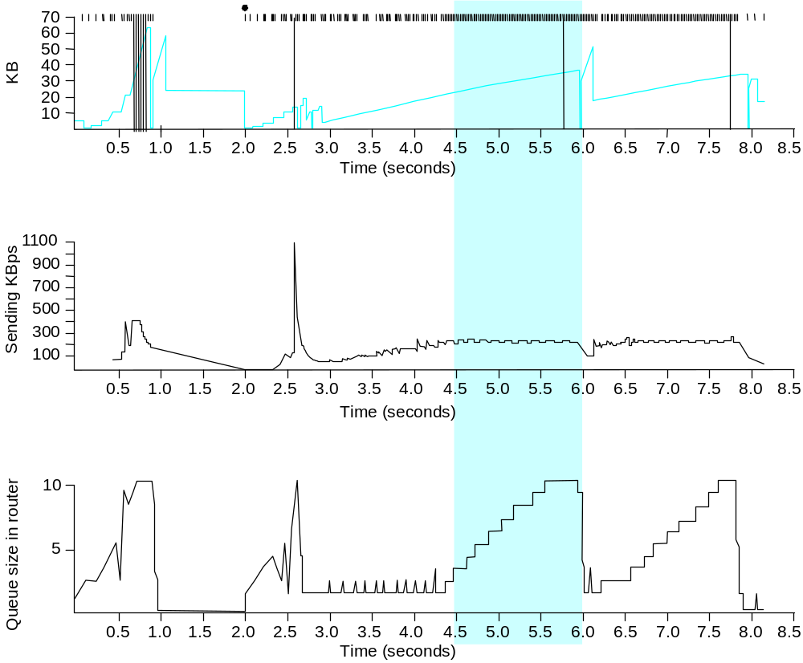
TCP Vegas
Idea: source watches for some sign that router’s queue is building up and congestion will happen too; e.g.,
  RTT grows
  sending rate flattens

Slide 26
Algorithm
Let BaseRTT be the minimum of all measured RTTs (commonly the RTT of the first packet)
If not overflowing the connection, then
ExpectRate = CongestionWindow/BaseRTT
Source calculates sending rate (ActualRate) once per RTT
Source compares ActualRate with ExpectRate
Diff = ExpectedRate - ActualRate
if Diff < α
increase CongestionWindow linearly
else if Diff > β
decrease CongestionWindow linearly
else
leave CongestionWindow unchanged

Slide 27
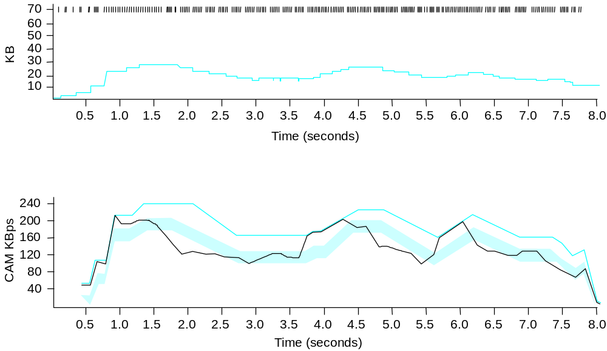
Algorithm (cont)
Parameters
  α = 1 packet
  β = 3 packets
Even faster retransmit
  keep fine-grained timestamps for each packet
  check for timeout on first duplicate ACK

